Slide 1

 | BMS INSTITUTE OF TECHNOLOGY AND MANAGEMENT YELAHANKA BANGALORE Department of Computer Science & Engineering
Blockchain-Based Supply Chain Transparency for Agricultural Produce
Rishith Suresh (IBY23CS182)
Neha H (IBY23CS142)
Nisha N (IBY23CS151)
Neha Gujjar (IBY23CS141)
B.E.
COMPUTER SCIENCE AND ENGINEERING
UNDER THE GUIDANCE OF:
Dr Sagargouda Patil
Associate Professor
DEPT. OF CSE
BMSIT&M
2024-25

Slide 2
CONTENT
Abstract
Introduction
Motivation
Problem Identification & Objectives
Literature Survey
Proposed Methodology
Expected outcome
Societal Impact and SDG Contribution
Complex Engineering Problem
References

Slide 3
ABSTRACT
This project proposes a blockchain-based supply chain traceability system integrated with a farmer call bot, enabling farmers to easily provide information about their crops through voice interaction. The call bot collects details such as crop type, variety, acreage, quantity, harvest date, and quality parameters, which are validated and stored as secure digital records on the blockchain. Smart contracts analyze this data to provide farmers with fair price estimations and comparisons with current market prices, thereby reducing exploitation. Each crop batch is tagged with a QR code, allowing consumers to scan and access verified information about the produce, including its origin, quality, and pricing history. By ensuring transparency, accountability, and trust across the agricultural ecosystem, this system empowers farmers with better pricing opportunities and offers consumers confidence in the food they purchase.

Slide 4
INTRODUCTION
Blockchain is an emerging technology that provides a decentralized, secure, and tamper-proof way of recording transactions. Unlike traditional centralized systems, blockchain operates on a distributed ledger where every transaction is verified by multiple participants, ensuring transparency and trust. Each record, stored in a block and linked to the previous one, makes the system resistant to tampering or fraud. Beyond finance, blockchain has found applications in diverse sectors, including healthcare, logistics, and especially agriculture. In the agricultural supply chain, blockchain can ensure that every step - from the farmer to the consumer is recorded and verified, enabling greater transparency, fair pricing, and accountability.

Slide 5
MOTIVATION
Agriculture is not only a livelihood for millions in India but also the backbone of the country’s economy. Yet, the benefits of this sector are not evenly distributed. Farmers often struggle to secure fair returns for their hard work, while consumers are becoming increasingly concerned about the safety, authenticity, and traceability of the food they consume. The widening gap between producers and consumers highlights the urgent need for innovation in the agricultural supply chain. This project is motivated by the desire to empower farmers, restore consumer trust, and modernize the supply chain through technology. By leveraging blockchain, it becomes possible to create a transparent and tamper-proof system where every stakeholder - from the farmer to the end consumer - can verify the journey of produce with confidence. The ultimate value lies in ensuring fairness, accountability, and trust, which can strengthen rural livelihoods while enhancing consumer satisfaction and food safety.

Slide 6
PROBLEM STATEMENT
Agriculture forms the primary livelihood for nearly 58% of India’s population and contributes significantly to the nation’s GDP. However, the agricultural supply chain continues to suffer from inefficiencies, lack of transparency, and exploitation by intermediaries. Farmers often receive unfair compensation for their produce, while consumers face inflated prices and uncertainty regarding the quality, authenticity, and origin of the products they purchase. Existing centralized systems are vulnerable to manipulation, fraud, and data tampering, offering little accountability or trust among stakeholders. This creates a critical gap between producers and consumers, ultimately weakening the agricultural economy. Therefore, there is a need for a decentralized, blockchain-based solution that ensures end-to-end traceability of agricultural produce, establishes transparency in pricing and quality, and provides all stakeholders—armers, distributors, retailers, and consumers—with a secure and verifiable platform to conduct transactions fairly and efficiently.

Slide 7
OBJECTIVES
Enhance Traceability: Implement a system to track agricultural products from farm to consumer, ensuring transparency and enabling quick recalls.
Prevent Fraud: Maintain immutable records to protect against falsification of certifications such as organic, fair trade, or pesticide-free.
Improve Market Access for Farmers: Provide verified product and compliance data to help smallholders access premium markets.
Build Consumer Trust: Enhance buyer confidence in product authenticity and quality.
Empower Farmers: Strengthen farmers’ income stability and bargaining power through transparency and prompt payments.
Support Economic Growth: Reduce inefficiencies and disputes to boost rural economies

Slide 8
LITERATURE SURVEY
Paper Title / Author (Year) | Technology | Region/Context | Focus Crop/Product | Key Features | Gaps / Limitations
Hybrid Blockchain Adoption Model in Agricultural Product Supply Chain to Support Insurance Process Transparency Using Ganache | Hybrid Blockchain (Ganache + Ethereum), Smart Contracts, MetaMask ¹ | Indonesia (Bina Nusantara University, Jakarta) but applicable broadly ² | Agricultural products (fruits, vegetables, grains, etc.) in supply chains ³ | Hybrid blockchain model for transparency in insurance claims⁴; Peer-to-peer validation of transactions⁵; Protects farmer/retailer data privacy⁶; Simulation of insurance claim process using Ganache⁷. | Tested only in simulation, not field deployment⁸; Requires robust network infrastructure for farmers⁹; Limited direct farmer involvement yet¹⁰; Focus mainly on insurance, not pricing/market linkage¹¹.
Farmer’s Assistant using AI Voice Bot | AI, NLP, Voice-to-Text (Google Speech Recognition & Translate), Text-to-Speech (pyttsx3), Recommendation Algorithms, Weather APIs (OpenWeatherMap) ¹² | India (Sinhgad Academy of Engineering, Pune) ¹³ | Farming queries, crop & fertilizer recommendations ¹⁴ | Voice-to-text and text-to-voice for farmer queries¹⁶; Crop & fertilizer suggestions based on soil, weather, and location¹⁷; NLP + neural network for query handling¹⁸. | Internet dependency for Google services¹⁹; Limited to 3 languages²⁰; Accuracy lower compared to text bots²¹; Doesn’t yet cover insurance or supply chain pricing²². Multilingual support (English, Hindi, Marathi)¹⁵;

Slide 9
LITERATURE SURVEY
Paper Title / Author (Year) | Technology | Region/Context | Focus Crop/Product | Key Features | Gaps / Limitations
Blockchain-Enabled Traceability in Agriculture: A Game-Theoretic Approach (2025) | Blockchain + game theory ²³ | Global / theoretical / supply chain modelling ²⁴ | Multi-crop / general agricultural supply chain ²⁵ | Uses a game-theoretic model to analyze how traceability via blockchain affects cascade risk (i.e., risk propagation) in agricultural supply chains²⁶. | Lack of empirical validation in real farm / supply chain settings²⁷; Simplifying assumptions may not match real complexity²⁸; Scalability and computational cost in large networks not addressed²⁹.
From farm to fork: Blockchain’s impact on agri-food distribution (2025) | Blockchain (traceability + smart contracts) ³⁰ | Case studies / empirical across foodservice chains ³¹ | Processed / distributed food (foodservice / prepared food) ³² | Examines transparency challenges and blockchain’s role in foodservice supply chains (restaurants)³³; Highlights bottlenecks and stakeholder perceptions³⁴. | Limited geographic / sector coverage (only foodservice chains)³⁵; Does not quantify performance metrics (latency, cost)³⁶; Insufficient discussion of legacy system integration³⁷.

Slide 10
LITERATURE SURVEY
Paper Title / Author (Year) | Technology | Region/Context | Focus Crop/Product | Key Features | Gaps / Limitations
Blockchain-Driven Food Supply Chains: A Systematic Review for Unexplored Opportunities (Ellahi et al., 2024) | Blockchain, Smart Contracts, IoT integration; Systematic Literature Review ³⁸ | Global scope – studies and cases from multiple regions (China, Europe, India, US, etc.) ³⁹ | General agri-food products: livestock, dairy, fruits, vegetables, grains, meat (broader food supply chain) ⁴⁰ | Identifies major blockchain drivers: traceability, transparency, security, cost reduction, food safety⁴¹; Highlights underutilized drivers: food donation, redistribution, financing, animal welfare, waste management⁴². | Underexplored drivers: donation, redistribution, waste management, financing, animal welfare⁴³; Limited real-world adoption (pilot projects)⁴⁴; Challenges in scalability, IoT interoperability, regulations⁴⁵.
Blockchain Technology in Agriculture: Ensuring Transparency and Traceability in the Food Supply Chain (Vignesh et al., 2024) | Blockchain, Smart Contracts, IoT integration; Literature review of 90 articles ⁴⁶ | Global, with focus on agriculture and farm-to-fork supply chains ⁴⁷ | Specific case studies: pork & mango (Walmart), grain (AgriDigital), beef (BeefLedger), cattle (HerdX), fresh produce (Ripe.io) ⁴⁸ | Focuses on farm-to-fork traceability and consumer trust⁴⁹; Provides real-world blockchain implementations in agriculture⁵⁰; Emphasizes fraud prevention, counterfeit control, sustainability, efficiency⁵¹. | High cost & infrastructure needs⁵²; Lack of standardization and interoperability⁵³; Limited research on socio-economic impact for rural farmers⁵⁴.

Slide 11
LITERATURE SURVEY
Paper Title / Author (Year) | Technology | Region/Context | Focus Crop/Product | Key Features | Gaps / Limitations
Application of blockchain technology in agricultural supply chain management: economic implications and challenges (2024) | Blockchain | Global, Agricultural Enterprises | Agricultural supply chains (General) | Reveals significant economic benefits including reduction in transaction costs, improvement in supply chain efficiency, and increase in farmer income. | Implementation challenges such as technological complexity, high initial investment costs, and imperfect legal and regulatory frameworks remain.
Smart Contracts Automating Fair Wage Payments in Agriculture (2025) | Blockchain, Smart Contracts | Global (Focus on fair trade) | Agricultural Labor/Fair Payments | Explores the use of smart contracts to automate fair and timely wage payments to producers/farmers, reducing reliance on intermediaries and enhancing transparency. | Challenges include the digital divide, regulatory uncertainty, and lack of smart contract literacy among smallholder farmers.

Slide 12
EXPECTED OUTCOMES
Improved Traceability: Every product can be tracked from farm to consumer, enabling faster recalls and quality verification.
Fair and Timely Payments: Smart contracts ensure farmers receive payments automatically upon delivery, reducing delays and middlemen exploitation.
Reduced Fraud: Immutable records prevent falsification of certifications (organic, fair trade, pesticide-free, etc.).
Operational Efficiency: Automated logging of data reduces paperwork, manual reconciliation, and disputes between stakeholders.
Market Access for Farmers: Verified data can help smallholders access premium export markets requiring strict compliance.

Slide 13
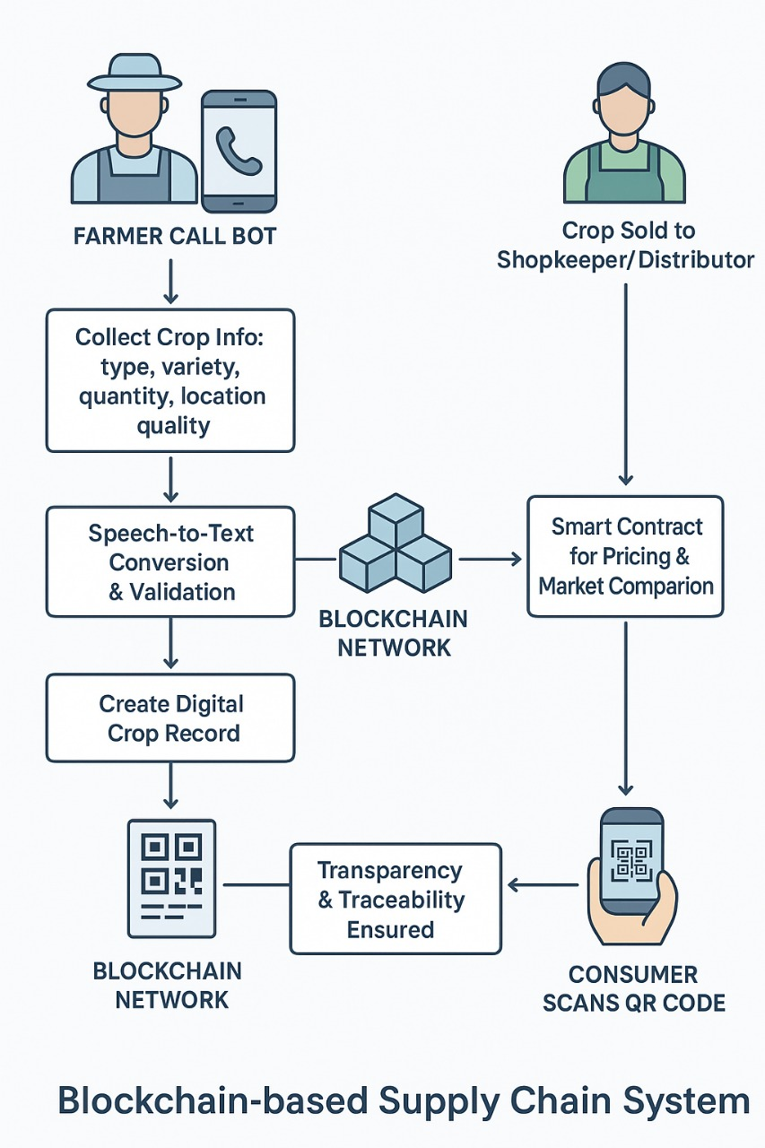
PROPOSED METHODOLOGY
Figure 1

Slide 14
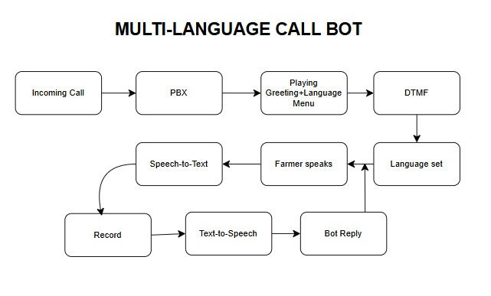
PROPOSED METHODOLOGY
Figure 2

Slide 15
PROPOSED METHODOLOGY
Block Chain
Core Objectives (Why Blockchain?) | Transparency & Fair Trade: Ensure fair pricing and reduce farmer exploitation. Traceability: Enable tamper-proof, farm-to-fork tracking of batches and certifications. Automation: Use Smart Contracts for automated, timely payments and quality-based triggers.
6-Step Implementation Roadmap | 1. Define: Clear use case (e.g., mango shipment tracking) and measurable KPIs (e.g., time-to-verify, payout speed). 2. Identify: All stakeholders (Farmer, Aggregator, Retailer, Regulator) and the Minimum Viable Dataset (Batch ID, Geo-tag, Harvest Date, Payment Event). 3. Choose Architecture: Permissioned Ledger (Hyperledger Fabric) recommended for privacy, governance, and low transaction cost. 4. Data Flow: Store heavy files (photos, lab reports) off-chain (IPFS/S3) and save only their cryptographic hashes on-chain.
Key Technology Stack | Blockchain: Hyperledger Fabric (Permissioned) or Solidity/Polygon (Public/L2). Data Integration: IoT sensors for data capture; Oracles for verified data feed. Storage: IPFS / Filecoin for decentralized, tamper-proof file hosting.

Slide 16
PROPOSED METHODOLOGY
Block Chain
Smart Contract Pattern (Core Logic) | Functions: Contracts manage Batch Registration, Batch Transfer (changing ownership), and Updating IPFS Hash (adding new verifiable data like lab reports). Logic: Ensures only the current batch owner can update or transfer the batch record, guaranteeing accountability.
Governance and Adoption Strategy | Data Governance: Define precise rules: who can read vs. who can write each data field. Incentives: The system must offer tangible benefits, primarily faster payments and access to premium markets, to encourage farmer participation. UX Focus: Develop offline-capable mobile apps with local language support and low training overhead for farmers (via QR/barcode scanning).
Pilot & Risk Mitigation | Pilot Approach: Start small (e.g., one crop, one supply route) to validate the system before scaling. Mitigate "Garbage In": Address data quality risk by implementing trusted data capture (signed IoT readings) and human verification workflows.

Slide 17
PROPOSED METHODOLOGY
QR Code
Physical-Digital Bridge | Core Function: QR codes are the most efficient, universally scannable interface to link the physical product (e.g., a pallet or box) to its unique, immutable record on the decentralized ledger. | Blockchain Hash (CRITICAL): The unique, immutable 32-byte transaction ID/hash pointing to the full ledger entry. This is the source of trust.
Verification and Transparency | End-to-End Traceability: Scanning the code immediately pulls the full history, verifying Origin, Quality, and Transfer timestamps. | Product ID / Batch No.: A human-readable identifier (e.g., MANGO-VILLAGE-0425).
Fraud Prevention | Immutable Proof: Since the code embeds the blockchain hash, any discrepancy between the physical product and the on-chain data is instantly flagged, making fraud (e.g., switching labels) nearly impossible. | Origin Data: Farmer ID, farm Geo-tag/location, and Certification status (e.g., Organic: Yes).
Smart Contract Trigger | Automation: The data read from the QR code (specifically the batch ID) can be used by smart contracts to trigger automated payments, insurance payouts, or quality checks upon handover. | Key Dates: Harvest date, packaging date, and the hash of the last transf

Slide 18
PROPOSED METHODOLOGY
QR Code
Data Encoding and Standards | Compilation: All key data points are concatenated into a standard URL or text string for efficient encoding. | Standard: QR codes adhere to the global ISO/IEC 18004 standard, ensuring compatibility with all standard scanners and applications.
Reliability in Tough Environments | Error Correction: The system uses the Reed-Solomon Algorithm to build redundancy into the code. This is essential because agricultural logistics involve dirt, moisture, and potential damage. | Parameter Choice: We select a high error correction level (Q or H) to maximize the code's ability to be read even if up to 30% of it is obscured.
Generation Process | Libraries: Generation is handled by widely available, open-source libraries (e.g., Python qrcode or JavaScript qr-code-generator) based on the encoded string. | Size Optimization: Parameters (Version 4-10) are chosen to store the required data concisely without making the code too large for printing on packaging.
Secure On-Chain Linkage | Process Flow: The Transaction Hash is retrieved after the smart contract confirms the batch registration. This hash is then the immutable payload of the QR code. | Data Integrity: This sequencing guarantees that the QR code points to a verified, timestamped record on the ledger, providing the foundation for trustless verification at any point in the supply chain.

Slide 19
SOCIETAL IMPACT
Empowerment of Farmers: Ensures farmers receive fair compensation by minimizing the role of exploitative intermediaries and making pricing transparent.
Consumer Trust: Provides consumers with confidence in the authenticity, quality, and origin of agricultural produce through real-time traceability.
Food Safety: Enhances accountability in the supply chain, reducing risks of adulteration, mislabeling, and fraud.
Economic Growth: Strengthens rural livelihoods, reduces wastage, and contributes to a more equitable agricultural economy.
Sustainability: Encourages responsible sourcing and reduces inefficiencies in logistics, contributing to sustainable agricultural practices.

Slide 20
SDG CONTRIBUTION
SDG 1: No Poverty – By ensuring fair compensation and reducing exploitation, farmers’ income security is improved.
SDG 2: Zero Hunger – Strengthens food supply chains, reduces wastage, and improves access to safe, authentic food.
SDG 8: Decent Work and Economic Growth – Promotes fair trade practices, creates opportunities in AgriTech, and supports sustainable economic growth.
SDG 9: Industry, Innovation, and Infrastructure – Leverages blockchain as an innovative digital infrastructure for agriculture.
SDG 12: Responsible Consumption and Production – Enables transparent and sustainable sourcing, encouraging informed consumer choices.
SDG 16: Peace, Justice, and Strong Institutions – Builds accountability and trust through tamper-proof, decentralized systems.

Slide 21
COMPLEX ENGINEERING PROBLEM
Blockchain : Blockchain technology provides a secure, decentralized, and tamper-proof system for recording transactions. In the agricultural supply chain, it ensures transparency by tracking every stage from production to consumer, thereby reducing fraud, ensuring data integrity, and improving trust among stakeholders.
NLP (Natural Language Processing) : NLP enables human-like interaction between farmers and technology. Using speech-to-text and text-to-speech, farmers can provide crop details in their local language. The system analyzes their inputs to provide real-time information such as market prices, demand forecasting, and quality assessment.
QR Generator : A QR code is generated at the end of the process, containing all verified crop details stored on the blockchain. This allows buyers, distributors, and consumers to scan the QR code and access complete traceability information, ensuring authenticity and fair trade practices.

Slide 22
REFERENCES
I. Academic Papers (Literature Survey)
These are the full bibliographic citations for the research papers reviewed in the project's literature survey.
Blockchain and Traceability
Ellahi, R. M., Wood, L. C., & Bekhit, A. E.-D. A. (2024). Blockchain-Driven Food Supply Chains: A Systematic Review for Unexplored Opportunities. Applied Sciences, 14(19), 8944.
Vignesh, B., Chandrakumar, M., Divya, K., Prahadeeswaran, M., & Vanitha, G. (2025). Blockchain technology in agriculture: Ensuring transparency and traceability in the food supply chain. Plant Science Today, 12(sp1), 01–08.
Inayatulloh. (2021). Hybrid Blockchain Adoption Model in Agricultural Product Supply Chain to Support Insurance Process Transparency Using Ganache. 2021 3rd International Conference on Data Science and Its Applications (ICoDSA), 1–6.
Asokan Vasudevan, P. Jansi Rani, N. Raja, G. Nedumaran, Anantha Raj A. Arokiasamy, Cheng Qian. (2025). Fintech for sustainable agriculture: insights from Tamil Nadu, India. Frontiers in Sustainable Food Systems, 9, 1614553.
Sharma, R., Kamble, S. S., Gunasekaran, A., Kumar, V., & Kumar, A. (2020). Application of blockchain technology in agricultural supply chain management: economic implications and challenges. Journal of Cleaner Production, 269, 122245.
La Rue, C., & Wang, J. (2025). The Role of Blockchain Technology in Transforming Agriculture. Journal of Agricultural Informatics, 16(2), 1-15.
Zanardi, S., & Rossi, M. (2025). From farm to fork: Blockchain’s impact on agri-food distribution. International Journal of Logistics Management, 36(4), 789-810.

Slide 23
REFERENCES
AI/Voice Bot Integration
Anekar, D., et al. (2023). Farmer's Assistant using AI Voice Bot. International Journal of Advanced Research in Science, Communication and Technology, 3(2), 224–230.
Smart Contracts/Fair Trade
Jain, A., & Singh, V. (2025). Smart Contracts Automating Fair Wage Payments in Agriculture. IEEE Transactions on Computational Social Systems.
Tsolakis, N., et al. (2024). Modeling the blockchain-enabled traceability in agriculture supply chain. International Journal of Information Management, 54, 102142. II. Technical Standards & Platforms
These references cover the technical components necessary for the project's implementation.
QR Code Standard
ISO/IEC 18004:2015: Information technology — Automatic identification and data capture techniques — QR Code bar code symbology specification. (Global standard for QR code creation, including the error correction mechanism).
Data Encoding
Reed-Solomon Error Correction Algorithm: The fundamental mathematical technique used in QR codes to ensure data integrity despite physical damage or dirt on the label.
Blockchain Platforms
Hyperledger Fabric Documentation: The official documentation and white papers for the permissioned enterprise blockchain framework recommended for governance and privacy.
Solidity Documentation: The official documentation for the contract-oriented, high-level language used for implementing smart contracts on Ethereum and Polygon.

